Slide 1
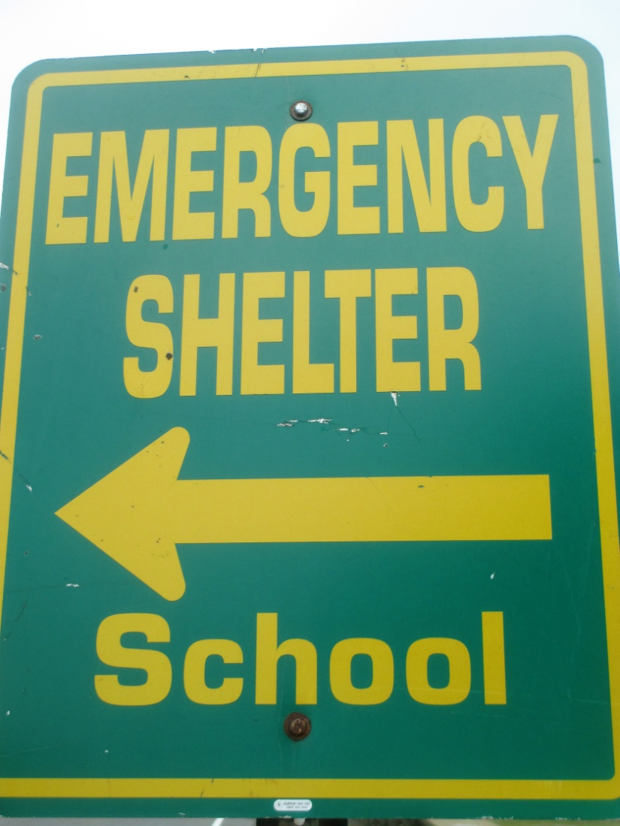
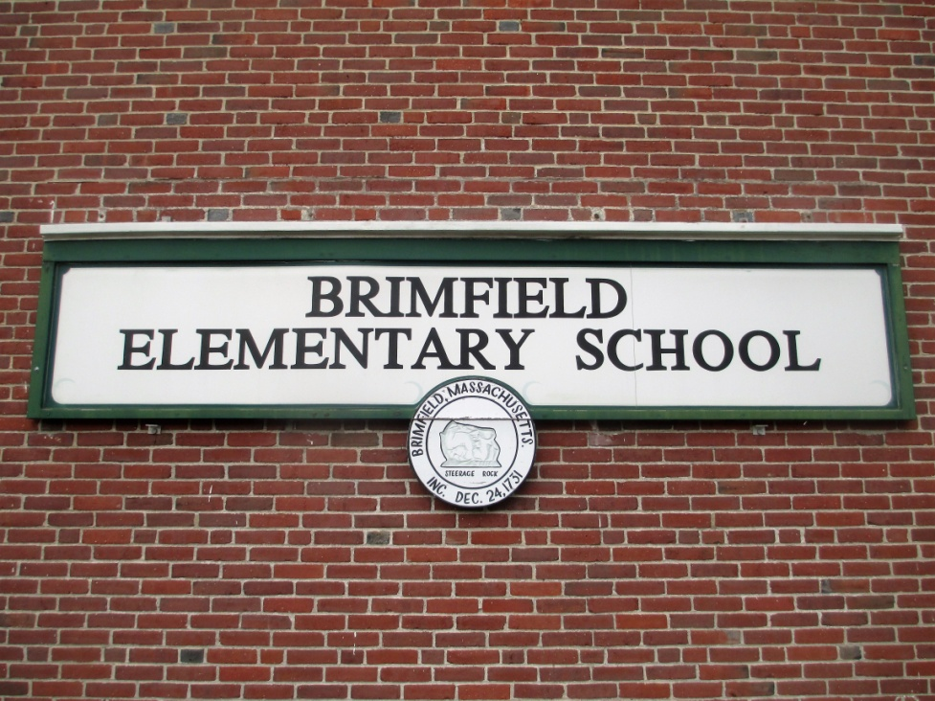
Do you know where the Brimfield Emergency Shelter is located?

Slide 2
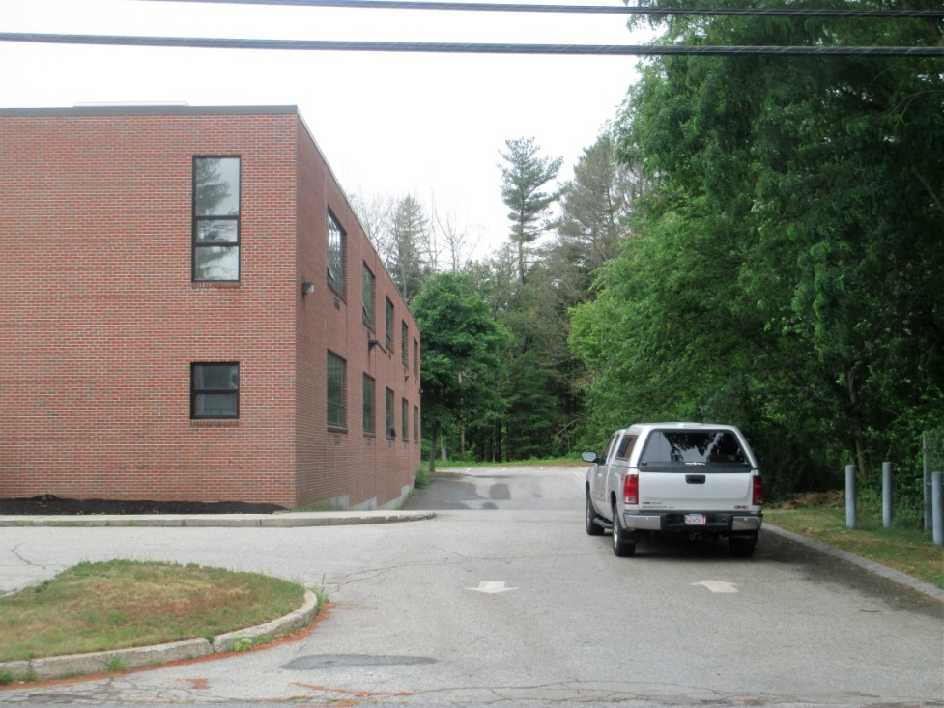
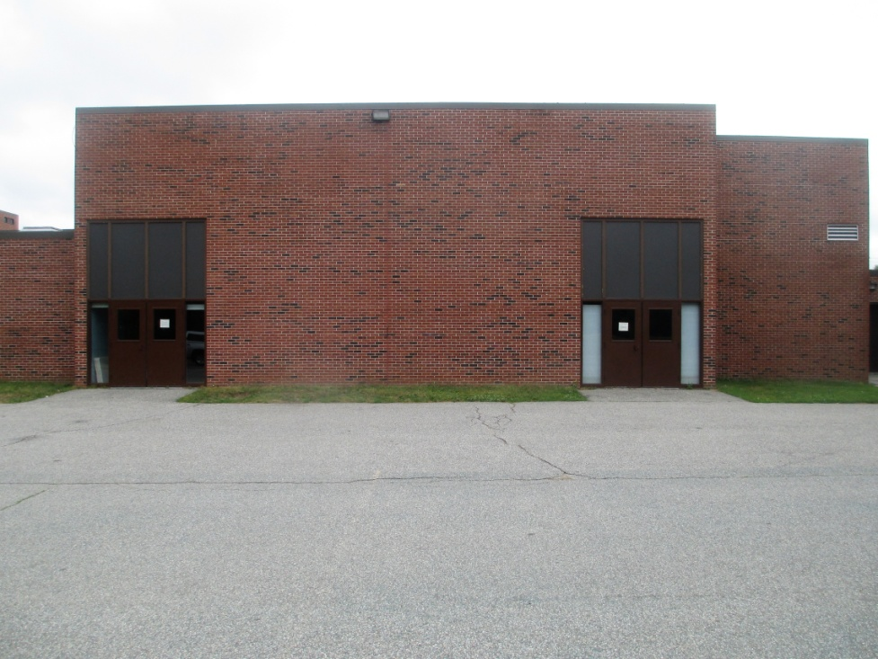
Go to the Rear of the Brimfield Elementary School
Enter the north (or right side) driveway
Enter the shelter through the left door into the cafeteria

Slide 3
What does the Emergency Shelter contain?
A trained local shelter crew including RN’s & EMT’s
A large emergency generator that goes on when the grid goes down to provide heat, light & electricity
Hot meals, fresh water, warm beds, dry clothes
First aid equipment

